Slide 1
Bitemporal Data Management
The Elephant in the Data Room
May 2019

Slide 2
Who?
Rob van Dort
freelance Data Architect
35 years ICT
Pet interests:
data
datamodels
metadata
(meta)data applications, Model Driven Development
(meta)data sets
“time traveling” / bitemporal – multi-dimensional data management
professional slogan: “data as infrastructure”

Slide 3
What?
Bitemporal Data Management, aka:
History in data
Time Traveling
Slowly Changing Dimensions
Time Varying Graph
Total Recall

Slide 4

Why?
Bitemporal Data Management is:
A fundamental feature
An essential feature
Too often overlooked
→ “The elephant in the Data Room”
Johan Cruijff, known for his
peasant-philosopher oneliners:
“You’ll only see it when you notice it”
Spoiler: bitemporal is (needed) (almost) everywhere…

Slide 5
Goals?
Educate on the subject
Create awareness among Architects
Learn from the EntityGrid concept
Brainstorm on relevance for your business context

Slide 6
How?
The “Bitemporal Maturity Ladder”
Bitemporal introduction
Examples
The EntityGrid concept
Demo
Wrap up & questions
Discussion: Bitemporal applied

Slide 7
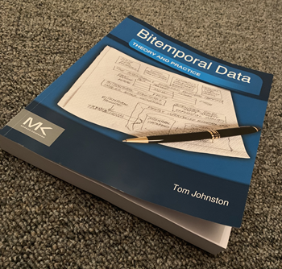
The “Bitemporal Maturity Ladder”
Basic ignorance → Bitemporal, what is it?
Practical ignorance → Do we need it?
Underestimation → Can’t be that hard…
Reality kicks in → Ouch, it’s complex, can’t we postpone?
In control → OK, we understand, let’s implement
360 pages…

Slide 8
Bitemporal introduction
History done well: bitemporal (two time dimensions)
Transaction time
Valid time (period, possibly from-to eternity)
Bitemporal enables:
Mutations “now”
Backward mutations: data should have been…
Forward mutations: data will be…
Queries on any point in time
For queries in the past:
Data as it *was* (never changes: idempotence)
Data as it *should have been* (may change with backward mutations)
Bitemporal requires:
No physical deletion of data (“Total Recall”)

Slide 9
Example 1: address change
You have an insurance policy
You move to another address
You forget to inform the insurance company
You don’t receive your annual policy copy
You call the insurance company and complain
They tell you they sent the copy, but appearantly to your old address
They change the address in the system
Transaction date = now
Valid date: from = date of your move, to = <infinity>
They can always explain why the policy copy was sent to the wrong address

Slide 10
Example 2: claim on insurance policy
You have an insurance policy for traveling
You lost your expensive sunglasses two years ago
You forgot to claim, but now you do
The insurance company will need to “go back in time”:
Did we know this customer <then>
Did he have a valid policy
Did the policy cover loss of sunglasses
What was the own risk amount <then>
…
→ reconstruct data, different objects related to eachother

Slide 11
Example 3: plant configuration (CMDB)
A production plant is a complex constellation of all kinds of machinery
Changes happen all the time (replacements, repairs, updates, …)
Incidents happen all the time
For analysis / predictive maintenance you need to know the *exact* configuration at the time of the incident

Slide 12
Example 4: master / reference data
You’ll want to keep history for your:
Customer data
Supplier data
Product data
Plant data
Employee data
…
Reference lists
…

Slide 13
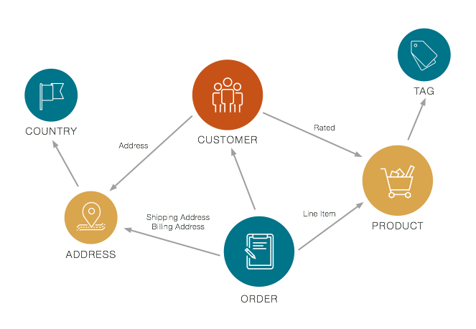
The EntityGrid concept – base concepts
Base concepts:
A dataset is modelled as a “graph of objects”
These objects represent things in the real world (“digital twins”)
Objects can be of various types
Objects have attributes with values
Objects can be connected on various ways (relations)
Attribute values can / will change over time
Relations can / will change over time
A dataset is managed as a whole
A dataset as a whole is bitemporal
Queries are bitemporal in nature
Queries yield a snapshot of any PiT
Bitemporal is handled by EG

Slide 14
The EntityGrid concept – features
Features:
Manage time in a dataset, modelled as a “graph of objects”
Automatic audit trails
Automatic lineage on attribute level
Fine grained authorisation (ABAC)
Non-blocking transactions
Easy to use API (read / write)
Easy snapshot creation for any point in time
Removes time handling from application
Ready for Blockchain (but efficient!)
More dimensions than two time dimensions
Multi-dimensional
Language-dimension already available
More dimensions possible (accuracy, multi-reality, level of detail, …)

Slide 15
Demo
Municipalities Demo - http://145.131.1.55/munidemo/956fbae
Introduction
The Municipalities Demo is inspired by the yearly pace of changes in municipalities in The Netherlands. This demo is based on EntityGrid, a "multi dimensional datastore", capable of registering and querying data in bitemporal and language dimensions.
The dataset
For this demo, data about Municipalities, Cities and Provinces have been integrated from various sources into one multi-dimensional datastore. Special attention has been paid to historic data.
Municipalities form an important governmental structure in a country. In The Netherlands there is a yearly pace of changes in municipalities, usually merges.
Over the years some 1700 municipalities have existed, of which currently (2019) only 355 remain. Multilingual aspects were implemented by registering Friese and Limburgse names where available.

Slide 16
Wrap up & questions
Bitemporal is too often overlooked, underestimated and/or partly / poorly implemented
Bitemporal should be applied on a complete dataset, not on single objects
Bitemporal should be handled by data infrastructure, not by individual applications
Questions?

Slide 17
Discussion: Bitemporal applied

